Slide 1




Now
Knows
Green
Supply Chain
Presenting
By
Daphne Liu
Smart
e-aware

Slide 2


GREEN COPONENTS
Green Journey
e
e-aware
Knows Co2
Co2 Intelligence
Discovery

Slide 3

Green Journey
e-aware
OUR APPROACH
CO2e Reduction
Minimize CO2e by Optimized FTL Load
Replaced Air Route with Rail Ocean ones at Order/Scheduling Time
Air & Ground
Air & Ground trip consolidation opportunity alert
CO2 Green Carriers
Air
Air route with minimum stops
Top CO2 friendly airlines
Notes:
Air

Slide 4
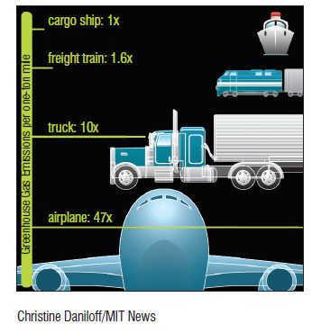
CO2e Reduction ML Model
Using CO2e emission Factors & Consolidation Algorithms
Green Journey
e-aware
Ground
Co2e emission factor (per Tonne Km ), on truck 3.5t > 7.5t > 20t > 40t
Based on cargo weight and select the minimum truck size CO2e factor
Trip consolidation algorithms based on [Origin] triggered at order level and advise consolidation opportunities
Shipping Unit Optimization from Package to Bulk/Pallet or Container
Rail route alert if city pair rail transits are available
(Smart Way for us, favorite CL)

Slide 5

Green Journey
Use Green Conscious Airlines
e-aware
Air
Co2e emission factor (per Tonne Km ), on aircraft Belly freight > Cargo plane
Prioritized air carriers from Cargo plane -> Belly freight
Prioritized air carriers by number of airport stops of each city pair
Top Co2e Airline Index
Shipping Unit Optimization from Package to Bulk/Pallet or Container
Ocean route alert if delivery date are 6 week ahead
(Smart Way for us, favorite CL)

Slide 6
Co2e Emission Intelligence
Green Journey
Knows Co2
Co2 Intelligence
Co2e Emission Indexes on Air, Ground, North America & Europe
Co2e Linear Regression Forecast Model on trend and season
Trip consolidation opportunity cluster model by OD path & Delivery Date
Co2e Emission Saving Calculator
See Dashboard Presentation
Dashboard

Slide 7
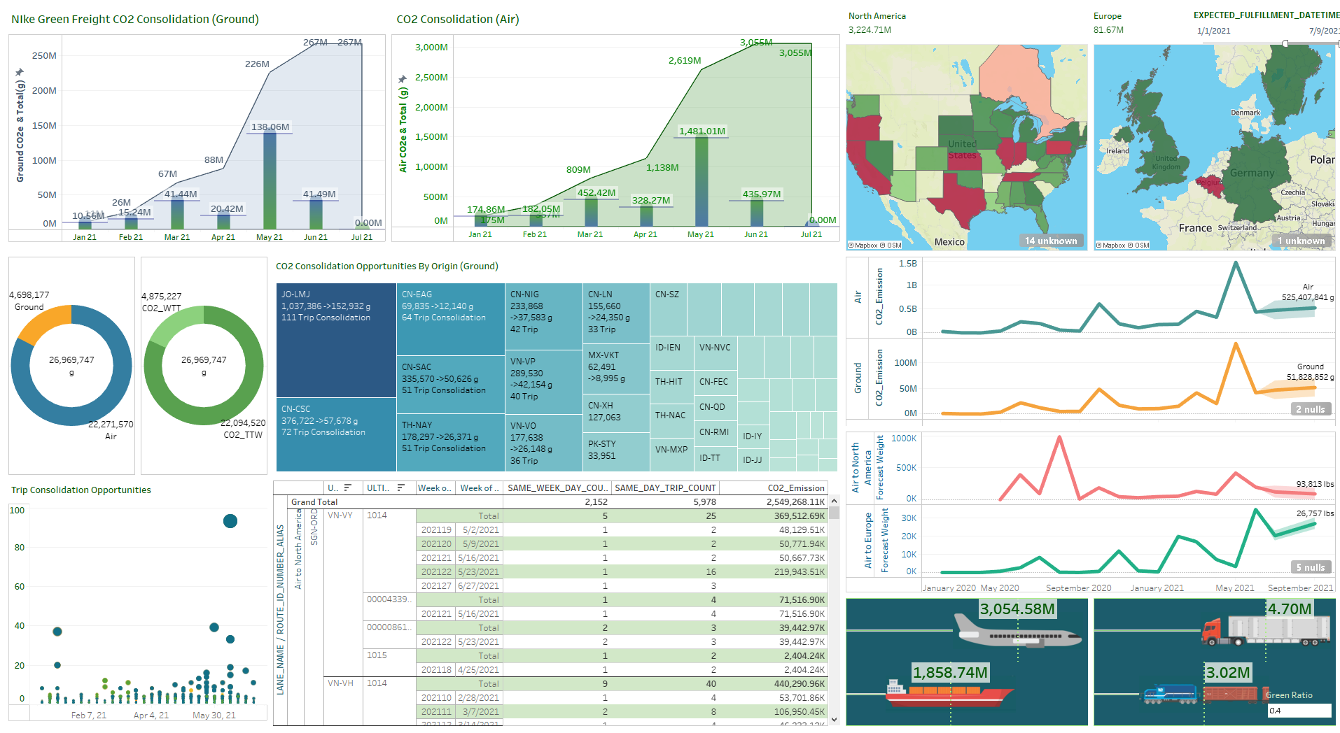
Green Journey
Knows Co2
Co2 Intelligence

Slide 8
e
Discovery
We can be more GREEN
Green Journey
City Pair based shipment CO2e discovery panel
CO2e forecast based on air/ocean port and routes
Interactive CO2 calculations driven by distance, weight & CO2e visualization
Consolidation opportunity advisor by day, week on air/ocean ports
Route wizard suggests CO2e reduction route and trip combination
Green calculator delivers optimized CO2e shipment and execution plan
Supply Chain
Smart

Slide 9
THANK YOU

